Slide 1

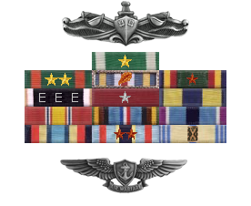
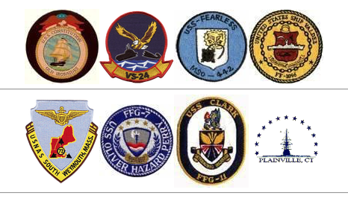
Welcome to CACO Training
Region Naval District Washington DC
Mr. Lou Montoya, CPO, USN, RET
Instructor – death case manager
202-369-6419
Mrs. Veronica (Roni) Shields
VSI-SI case manager
203-369-0737
Luis.e.montoya2.civ @ us.navy.mil

Slide 2
One Day Program Demo:
0800 Module 1: Introduction
0900 Module 2: notification
1130 Lunch
1200 Module 3 : funeral arrangements
1330 Module 4 : The benefits VISIT
1500 JKO Notification
** Once I have your JKO CERTs, I will provide your CACO certificate and credit you in FLTMPS.
Notes:
I will create all the certificates and have them standing by to send them as soon as I get their JKO certs.
When I get a seat request, I send them a link to the CACO Resources Page (usually the roght page is the top hit in Google search) and direct them to download the FY22 CACO Training requirements, the manuals and the forms needed for class.

Slide 3
Components of a CACO Case:
The Command
The NOK
PERS/Navy Casualty
- Makes the Personal Casualty Report via DCIPS LINK and uploads the most up-to-date OFFICIAL (signed) BENEFICIARY paperwork for the deceased.
- Responsible for Line of Duty Investigation, Escort, Returns HHG, ensures the deceased has uniform, plans UNIT Memorial Service.
- Assigns a Command Representative (CACO-trained individual) to work with Region and keep CO current on the case.
-Entitled to in person official Navy notification by trained CACO.
-Receives assistance to claim other entitlements, such as:
*Death Gratuity
*Unpaid Pay and Allowances
*SGLI, PERSEFF, SBP, Funeral Expenses, and more.
* New ID Card, MGIB refund.
- A Case Manager to review benefit entitlements and to work the case with Regions and Commands.
- Needs Information from CACOs (via Region) to make benefits decisions.
- Over a dozen OPNAV, DOD, and Standard Forms are needed with signatures from CACOs and NOKs to fulfill benefit entitlements.
- PERS pays for all authorized travel related to the death.

Slide 4
So…. Where do CACOs come from?
Parent Command
If the NOK Resides within 50 Miles from the Command
Subarea Coordinator
Designated by Regional Commander to support NOK in their AOR
Military Hospital
Trained CACOs to assist families flying in from out of town

Slide 5
Funeral and Memorial Travel
MILPERSMAN 1770-270 and 271 states who are entitled to funded travel to an ACDU Funeral and Memorial. The PADD establishes the official ceremony.
PERS (Navy Casualty) is the funding authority for their travel.
Only Hotel, Per-diem, and Air Fare are covered expenses.
Rental Cars are NEVER authorized for funeral or memorial travel ITOs.
Local Courtesy CACOs are assigned to support NOK attending the ceremony. Commands must provide local transportation from the airport to the hotel, to the cemetery, and return.
For Arlington National Cemetery in Arlington, VA, when parent command support is not possible, NDW is responsible for supporting the authorized travelers.
For effectiveness, NDW Courtesy CACOs will coordinate with NOK CACO.

Slide 6
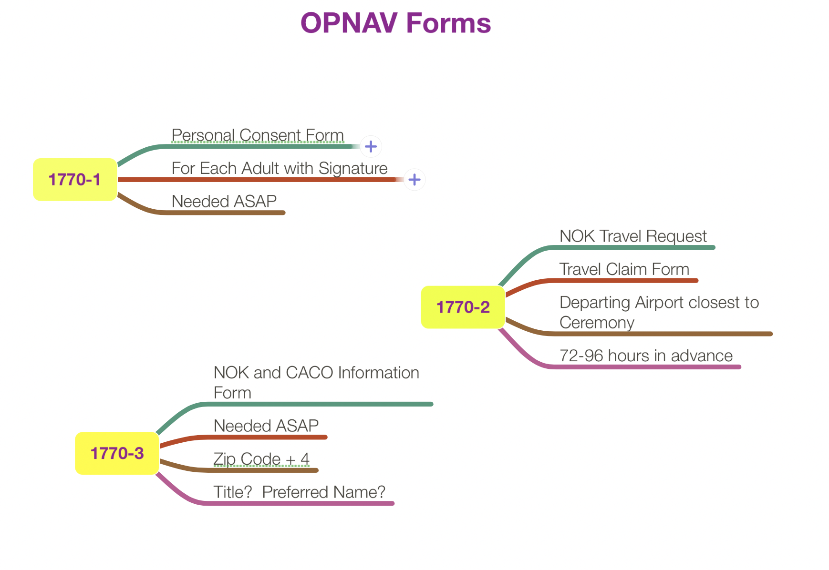
Notes:
We will look at the forms next, here is a snapshot of what you need to know abut the forms

Slide 7
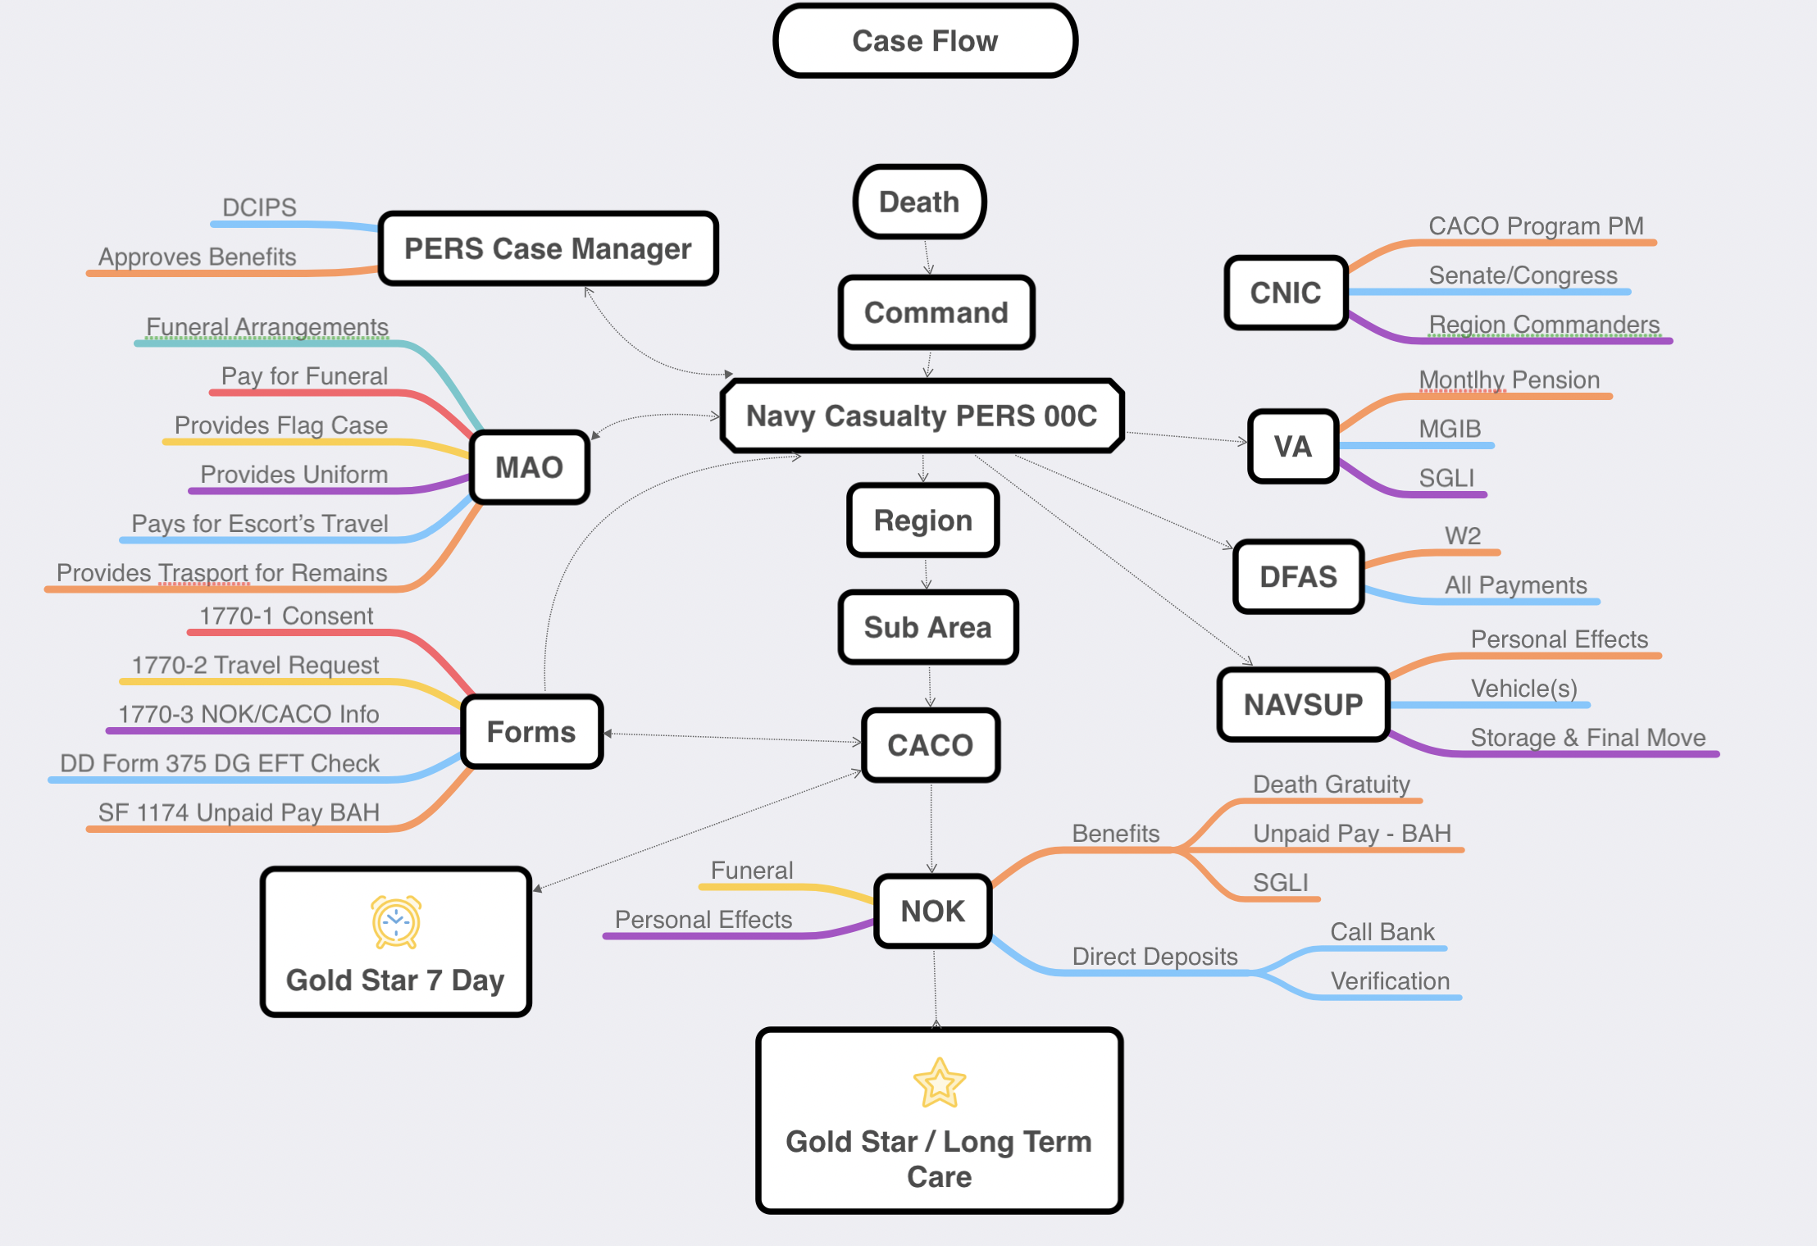
Notes:
This capture illustrates all the important players and details of a case in one shot. The part at the bottom (CACO) is what we have control of but the work the CACO does, goes back to all the agencies involved, illustrated on the sides of the slides. You have a center line and the peripherals.

Slide 8
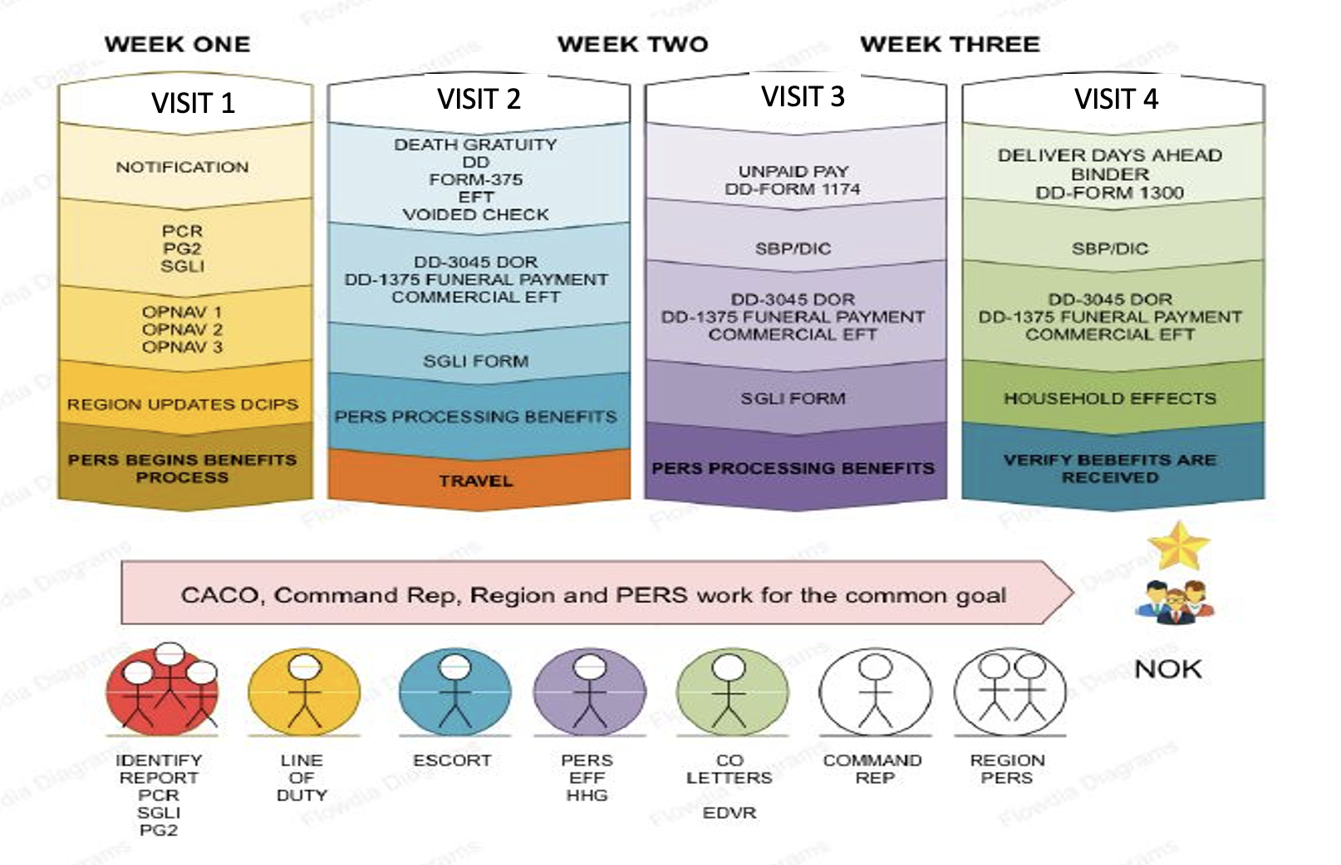
Notes:
CACOs wonder how long a case takes? XO’s wonder, what do I need to do to close this case?
The top row illustrates the various visits to the NOK to attain the information, on forms, needed to make sure they receive their entitlements.
The bottom row, with the circles, represents the players at the command that need to be selected/designated by the CO to carry out their list of responsibilities.
The pink arrow in the middle states our mission to work together to get the family to Gold Star. The sooner we get there the sooner the NOK can start the rest of their lives, knowing that we did all we had to do for them.

Slide 9
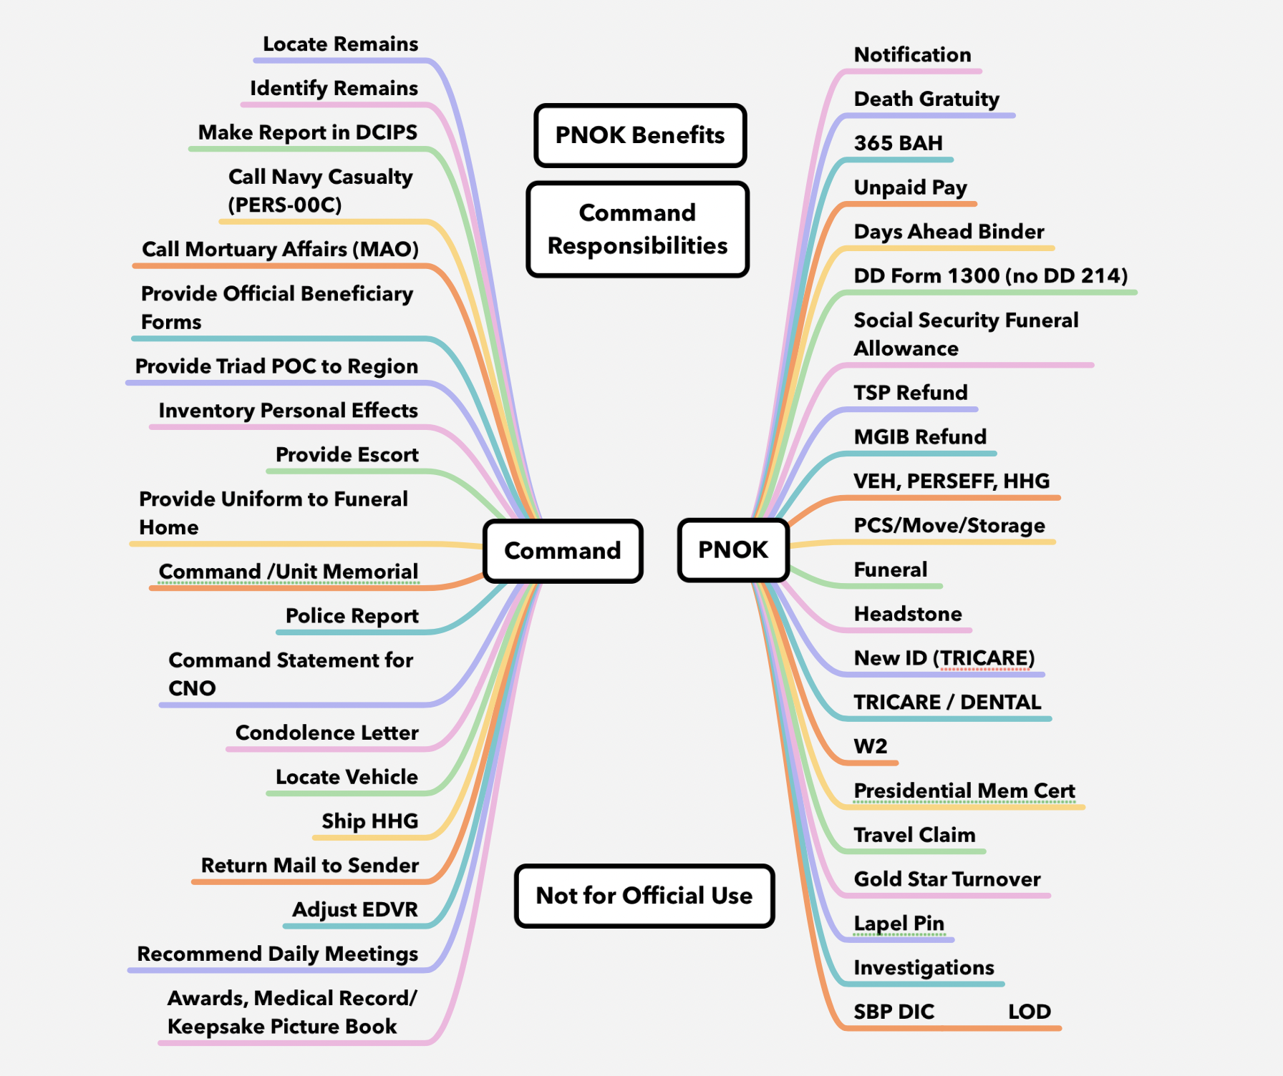
Notes:
This chart illustrates all likely command responsibilities and all the possible benefits an NOK may be entitled to. This shows, at a glance what needs to happen in a case in order for us to close the case.

Slide 10
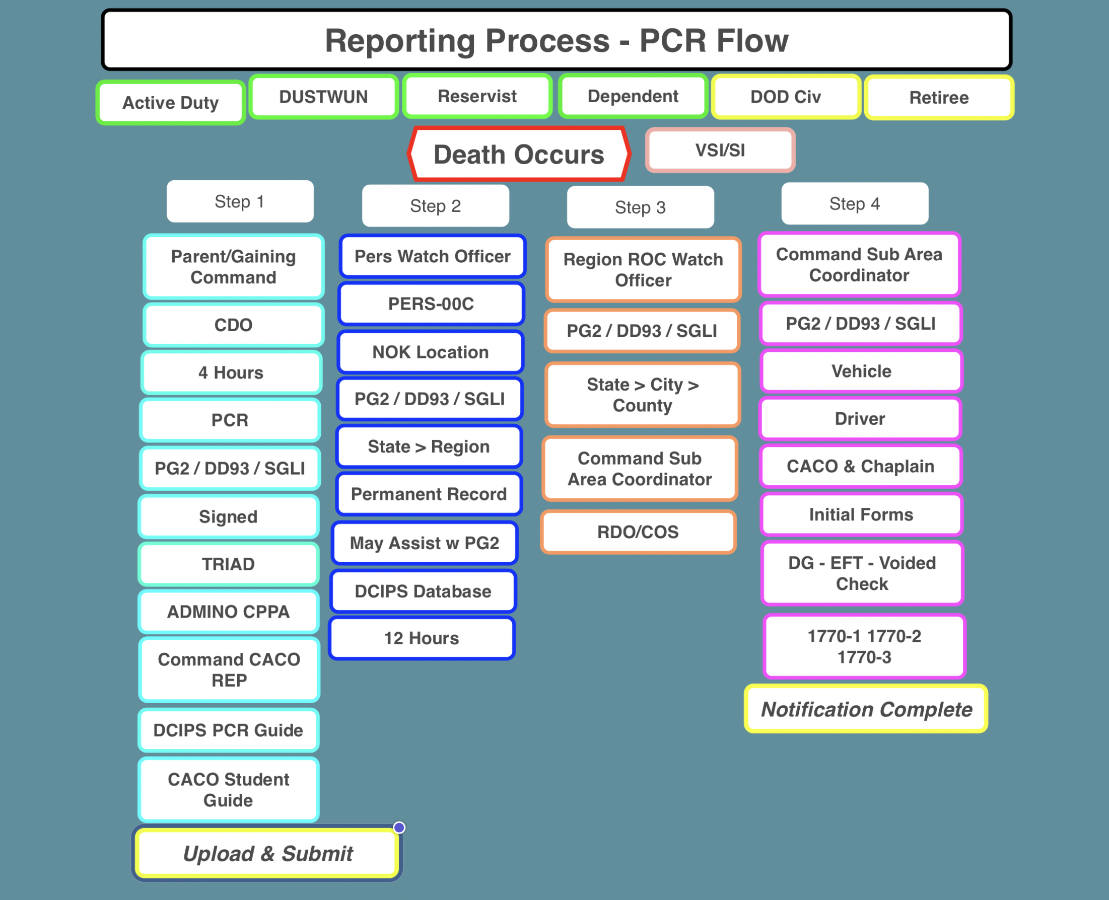
Notes:
Often the CO wants to know why it takes so long for a notification to take place. We illustrate that here, how the case starts at the top with the green boxes, including what constitutes a reportable event (Retiree is an option/not mandatory). Step 1 are all the components and actions from the command to create the PCR. In all the subsequent steps you see talking points to understand the steps that follow at each stage of the routing process. Each step takes hours.

Slide 11
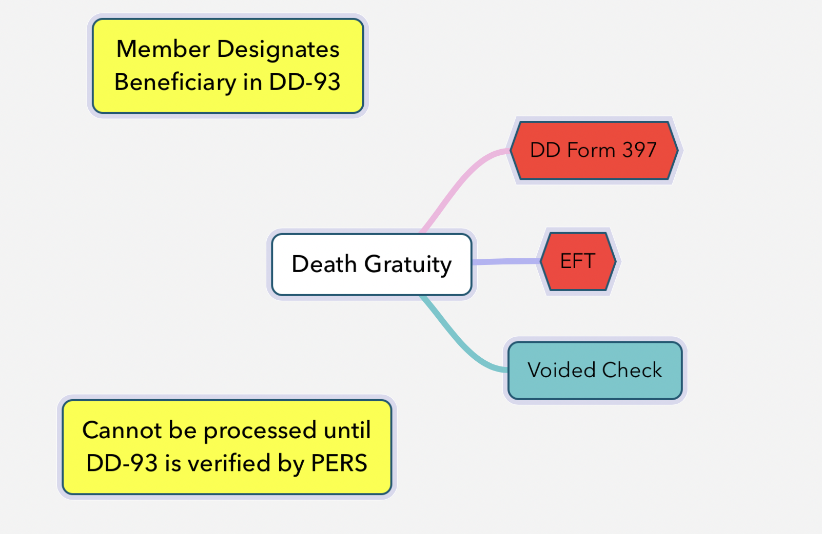
Notes:
We will look at the forms next, here is a snapshot of what you need to know abut the forms.
The CACO needs to suggest to the NOK to call the bank and ask the bank does not close their account when the large amounts of money are deposited. Also the routing number has to be 100% accurate, if unsure of the routing number, calling the bank is the best option.

Slide 12
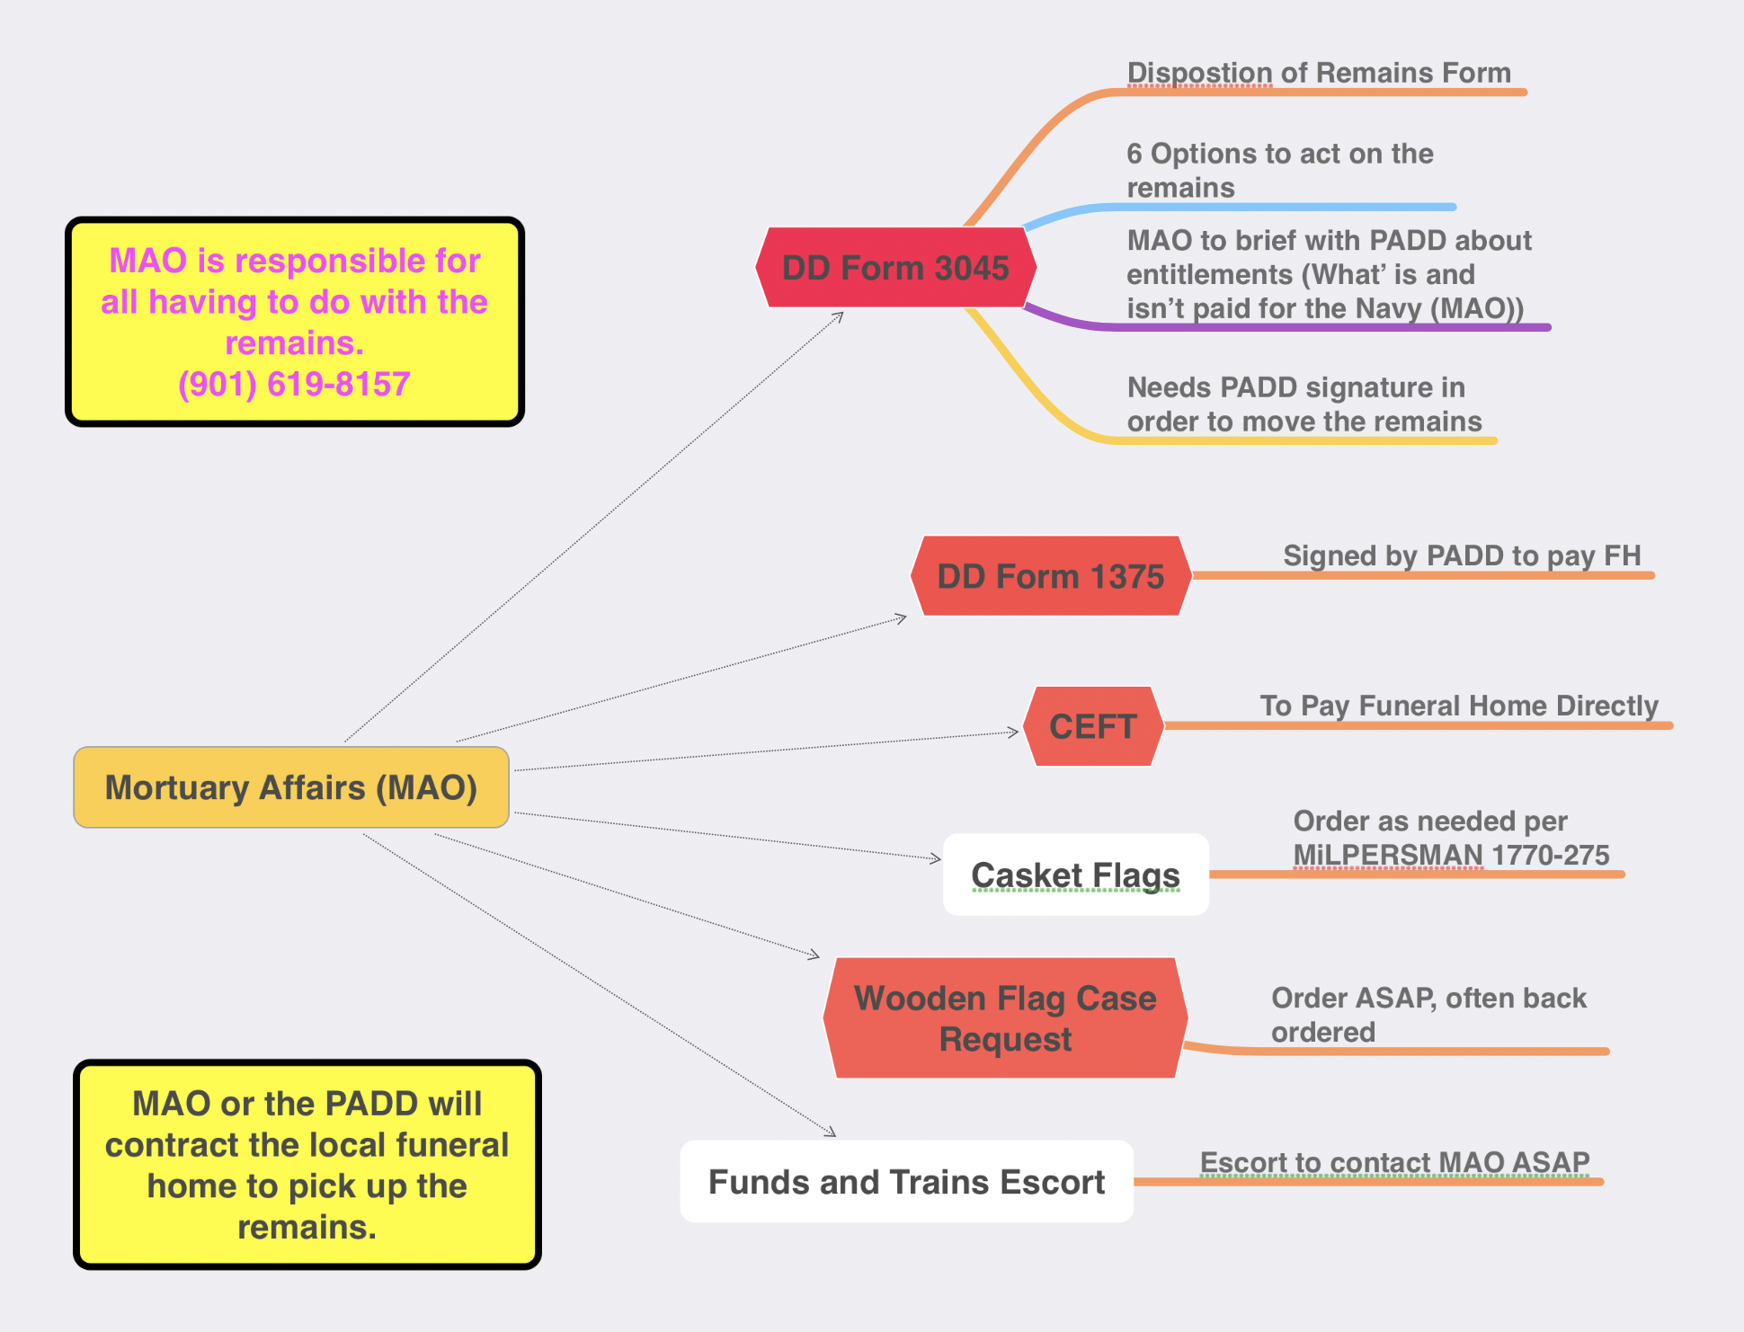
Notes:
These slide will acquaint the CACO with the MAO forms that need to be done in the case and which must discussed with MAO.

